Slide 1
RA Didactics: R Week 3
Jon Clucas and Bonhwang Koo

Slide 2
Last last week
File handling
Operations
Boolean Logic and Conditional Statements
Loops

Slide 3
plot
1 or 2 dimensional data:
1-dimensional: plot(value_vector) plots the values on the y-axis against the index (row number) on the x-axis
2-dimensional: plot(x, y) plots the vectors in a 2-dimensional space with the first vector on the x-axis
Notes:
https://www.datacamp.com/community/tutorials/15-questions-about-r-plots#gs.z02QcdU

Slide 4
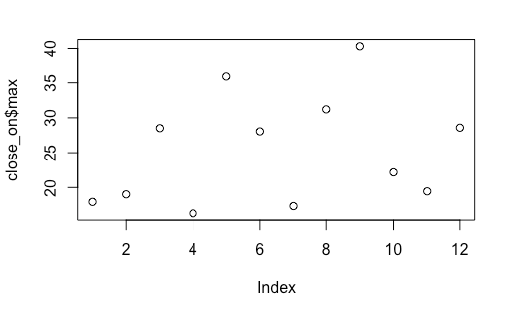
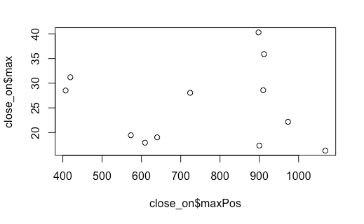
Plot: 1-dimensional vs. 2-dimensional

Slide 5
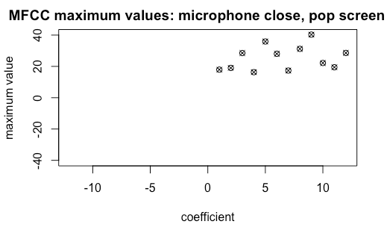
Graphical Parameters
plot(x, y, …)
Many graphical methods accept arguments to modify a plot:
main (title)
sub (subtitle)
xlab and ylab (axis labels)
xlim and ylim (axis ranges)
pch (specify shape of points) (?pch)
col (color)
Most plotting functions can take these parameters.
The title() function can specify main, sub, xlab, ylab and others after the plot has been created.
Notes:
List of pch symbols: http://www.endmemo.com/program/R/pchsymbols.php

Slide 6
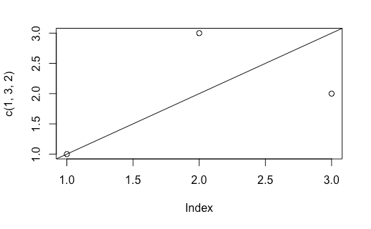
abline
abline(intercept, slope)
for x = y: abline(0, 1) (because x = 0 + 1y)

Slide 7
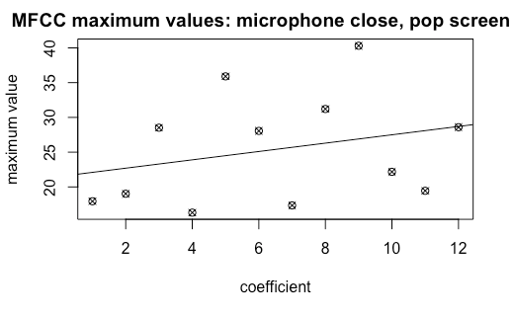
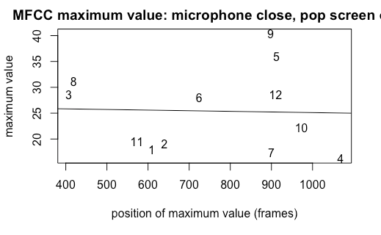
abline(lm(y ~ x)): line of best fit
lm = linear model; y ~ x indicates a function: f(x) = y

Slide 8
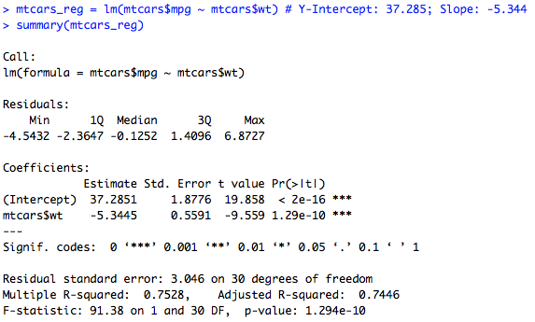
line of best fit
abline(lm(y~x)) # lm stands for linear model
Y-intercept = 37.2851
Slope = -5.3445
p < 0.001; slope is significantly different from 0, providing evidence of negative correlation between fuel efficiency and weight

Slide 9
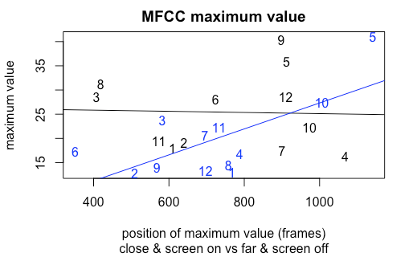
points(x, y)
Takes the same parameters as plot(x, y), but adds to the current plot instead of building a new one.

Slide 10
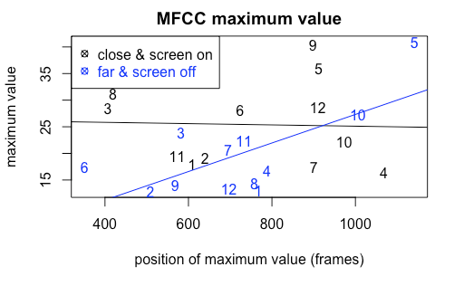
legend (x, y, legend-text-vector, add’l-params)

Slide 11
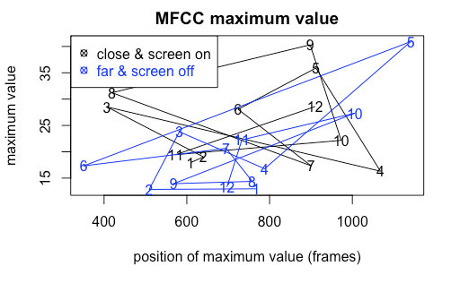
lines(x, y)
Connects points in vectors x & y

Slide 12
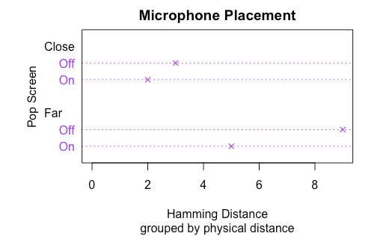
dotchart
Sometimes other types of plotting are more appropriate.
A Cleveland dot plot is good for grouped one-dimensional data.
Most can take the same parameters as plot.

Slide 13
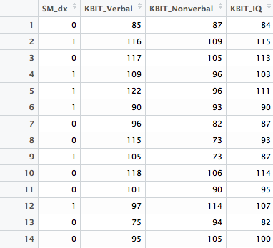
SM KBIT Data

Slide 14
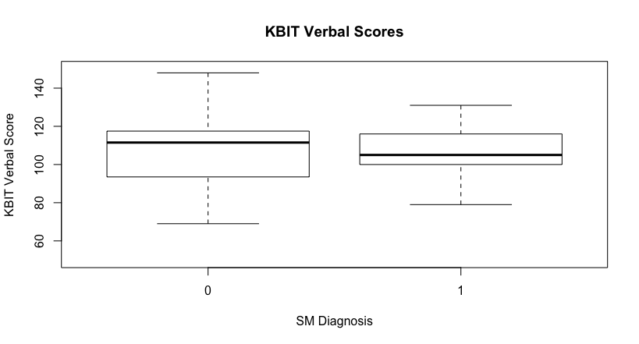
Box Plot
boxplot(x, data =, ...)
Notes:
http://www.statmethods.net/graphs/boxplot.html

Slide 15
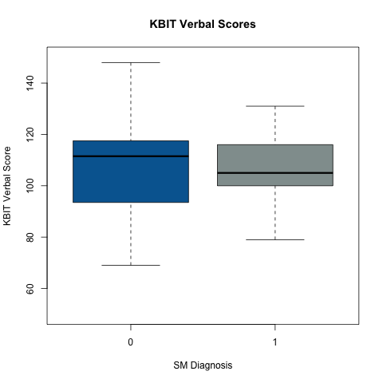


Slide 16
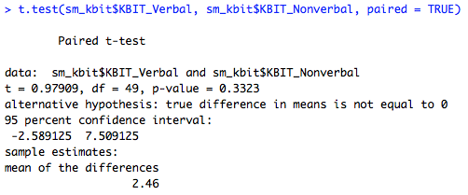
t.test(y1, y2) # y1 and y2 are both numeric

Slide 17
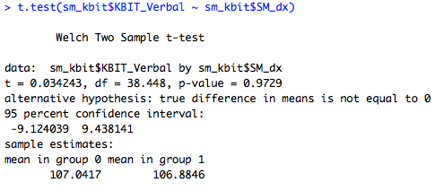
T-Test
t.test(y ~ x) # y is numeric and x is a binary factor (category)
Notes:
http://www.statmethods.net/stats/ttest.html

Slide 18
ANOVA: ANalysis Of VAriance
A family of statistical methods; we’ve already done two types of ANOVA today:
Linear Modeling
t-Test
aov(formula, data, …)
Notes:
ANOVA generally: https://en.wikiversity.org/wiki/Analysis_of_variance
ANOVA in R: http://www.statmethods.net/stats/anova.html

